Slide 1
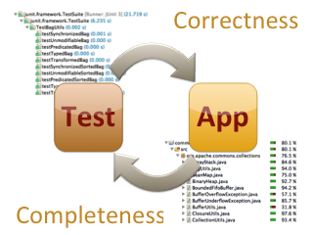
While the existing tests verify the correctness of the code under test there is no guarantee that the entire code base is actually tested.

Slide 2
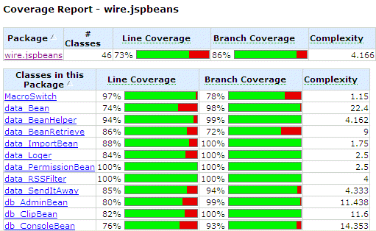
Code Coverage Report

Slide 3
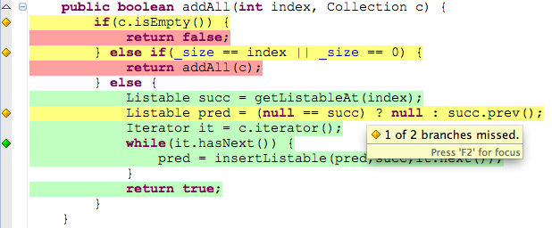
Green lines were fully executed, yellow lines were executed partially only and red lines were not hit at all. Little diamonds symbols in the editor's ruler, on the left to the source code, show the execution status of branches in your code

Slide 4
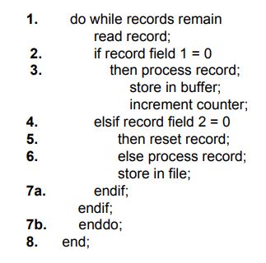
Draw control flow graph of the following program

Slide 5
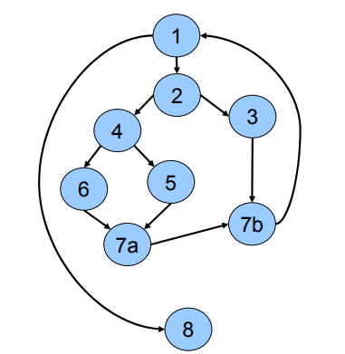
Answer to question on previous slide

Slide 6
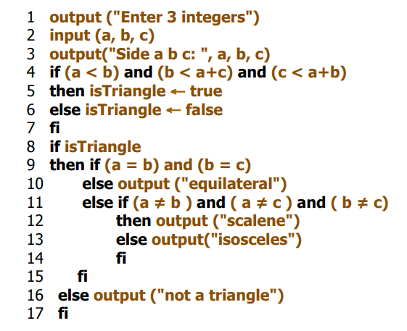
Draw control flow graph of the following program (Triangle Program)
Should be Then

Slide 7
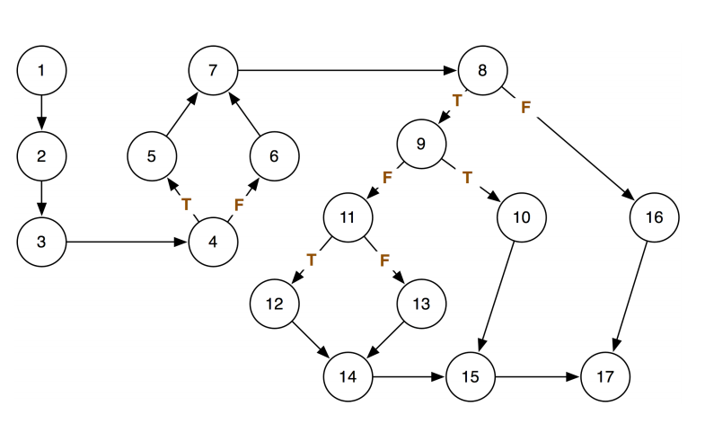
Answer to question on previous slide

Slide 8
Compound Condition Coverage
What if the compiler generates code that masks the evaluation of conditions?
That is, suppose
if (A) or (y/x=5) then...
is compiled in such a way that if A is true, y/x=5 will not be evaluated.

Slide 9
Compound Condition Coverage (cont’d)
Compound Condition Coverage requires that all combinations of condition values at every branch statement will have been covered, and that every entry point will have been taken, at least once.
Also know as Multiple Condition Coverage.
Subsumes Branch/Condition Coverage, regardless of the order in which conditions are evaluated.

Slide 10
Compound Condition Coverage (cont’d)
Combinations of condition values: TT, TF, FT, FF
input(X,Y)
if (Y<=0) or (X=0) then
Y := -Y
end_if

Slide 11
Condition Coverage
something(int x)
{
if (x < 0 || y < x)
{
y := -y;
x := -x;
}
z := x;
}
Does test set {(x=−1, y= −2), (x=1, y=1)} achieve multiple condition coverage ? If not Why ?
B0
(x < 0 || y < x)
true
false
B1
y := -y;
x := -x;
Control Flow Graph
B2
z := x

Slide 12
Condition Coverage
something(int x)
{
if (x < 0 || y < x)
{
y := -y;
x := -x;
}
z := x;
}
Test set {(x=−1, y= −2), (x=1, y=1)} does not achieve multiple condition coverage since we did not observe the following truth assignments
  term1=true, term2=false
  term1=false, term2=true
B0
(x < 0 || y < x)
true
false
B1
y := -y;
x := -x;
Control Flow Graph
B2
z := x

Slide 13
Path Coverage
Path Coverage requires that all program paths will have been traversed at least once.
Often described as the “strongest” form of logic coverage? (Is it stronger than Compound Condition Coverage?)
Path Coverage is usually impossible when loops are present.

Slide 14
How many Unique Paths ?
for I = 1 to 30 do
input(X,Y)
if (Y<=0) then
if (X<=0) then
Y := -X
else
Y:=-Y
end_if_else
else
Y := X+Y
end_if_else
end_for_do
repeat 29 times

Slide 15
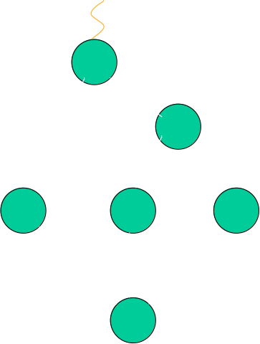
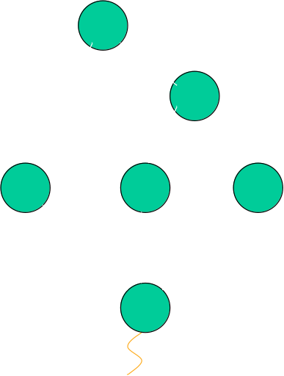
Path Coverage (cont’d)
3 paths
3 X 3 = 9 paths
3 paths

Slide 16
Path Coverage (cont’d)
repeat 29 times
3 X 3 X…X 3
= 3 paths
30

Slide 17
Path Coverage
B0
areTheyPositive(int x, int y)
{
if (x >= 0)
print(“x is positive”);
else
print(“x is negative”);
if (y >= 0)
print(“y is positive”);
else
  print(“y is negative”);
}
(x >= 0)
true
false
B1
B2
print(“x is p”)
print(“x is n”)
B3
(y >= 0)
true
false
B4
B5
Test set:
T₂ = {(x=12,y= − 5), (x= −1,y=35)}
Branch, statement, condition, path ?
print(“y is p”)
print(“y is n”)
B6
return

Slide 18
Path Coverage
B0
areTheyPositive(int x, int y)
{
if (x >= 0)
print(“x is positive”);
else
print(“x is negative”);
if (y >= 0)
print(“y is positive”);
else
  print(“y is negative”);
}
(x >= 0)
true
false
B1
B2
print(“x is p”)
print(“x is n”)
B3
(y >= 0)
true
false
B4
B5
Test set:
T₂ = {(x=12,y= − 5), (x= −1,y=35)}
Branch =yes, statement = yes, condition =yes, path = no?
print(“y is p”)
print(“y is n”)
B6
return
Set of all execution paths: {(B0,B1,B3,B4,B6), (B0,B1,B3,B5,B6), (B0,B2,B3,B4,B6), (B0,B2,B3,B5,B6)}
Test set T₂ executes only paths: (B0,B1,B3,B5,B6) and (B0,B2,B3,B4,B6)

Slide 19
Path Coverage
B0
areTheyPositive(int x, int y)
{
if (x >= 0)
print(“x is positive”);
else
print(“x is negative”);
if (y >= 0)
print(“y is positive”);
else
  print(“y is negative”);
}
(x >= 0)
true
false
B1
B2
print(“x is p”)
print(“x is n”)
B3
(y >= 0)
true
false
B4
B5
Test set:
T₂ = {(x=12,y= − 5), (x= −1,y=35)}
Branch =yes, statement = yes, condition =yes, path = no?
print(“y is p”)
print(“y is n”)
B6
return
Provide a test case which gives all the 4 types of coverage

Slide 20
Path Coverage
B0
areTheyPositive(int x, int y)
{
if (x >= 0)
print(“x is positive”);
else
print(“x is negative”);
if (y >= 0)
print(“y is positive”);
else
  print(“y is negative”);
}
(x >= 0)
true
false
B1
B2
print(“x is p”)
print(“x is n”)
B3
(y >= 0)
true
false
B4
B5
print(“y is p”)
print(“y is n”)
B6
return
Test set:
T₁ = {(x=12,y=5), (x= −1,y=35),
(x=115,y=−13),(x=−91,y= −2)}

Slide 21
Class Exercise
READ temp
READ hour
IF hour > 12 OR temp < 70 THEN
PRINT "eat lunch"
END IF
PRINT "go "
IF temp > 75 THEN
PRINT "swim"
END IF

Slide 22
hour = 13, temp = 77
2) hour = 14, temp = 74
3) hour = 10, temp = 80
hour = 13, temp = 80
4) hour = 10, temp = 80
hour = 13, temp = 80
hour = 13, temp = 73
5) hour = 10, temp = 80
hour = 13, temp = 80
hour = 9, temp = 60
What coverage is provided
By each test suite and what
is missing ?

Slide 23
Path Coverage (cont’d)
Various strategies have been developed for identifying useful subsets of paths for testing when Path Coverage is impractical:
  Loop Coverage,
  Basis Paths Coverage, and
  Dataflow Coverage.

Slide 24
Loop Coverage
Loop Coverage requires that the body of loops be executed 0, 1, 2, t, max, and max+1 times, where possible.
Rationale:
  0: Is some action taken in the body that must also be taken when the body is not executed?
  1: Check lower bound on number of times body may be executed.

Slide 25
Loop Coverage (cont’d)
Rationale: (cont’d)
  2: Check loop re-initialization.
  t: Check typical number of iterations.
  max: Check upper (valid) bound on number of times body may be executed.
  max+1: If the maximum can be exceeded, what behavior results?

Slide 26
Summary of White-Box Coverage Relationships (so far…)
Compound Condition
Path
Branch / Condition
Loop
Condition
Branch
Statement

Slide 27
declare Length as integer
declare Count as integer
READ Length;
READ Count;
WHILE (Count <= 6) LOOP
IF (Length >= 100) THEN
Length = Length - 2;
ELSE
Length = Count * Length;
END IF
Count = Count + 1;
END;
PRINT Length;
Write minimal test-cases and expected outcome
To get 100% branch coverage

Slide 28
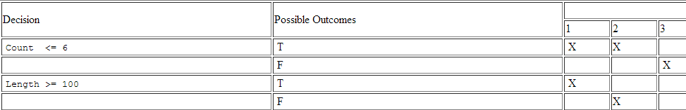
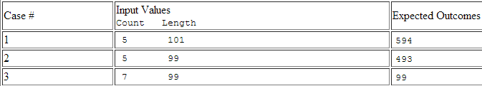

Slide 29
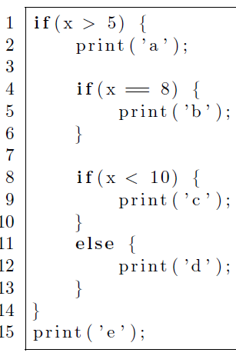
Write all possible combinations of output and
Write minimal test-cases to get 100% branch coverage
(write the test-case and expected output)

Slide 30
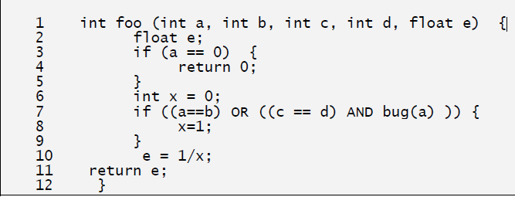
Bug(a) method returns a false value if fed any integer greater than 1
Write test-cases for statement, branch and condition coverage
First Draw a CFG using short-circuit Boolean evaluation

Slide 31
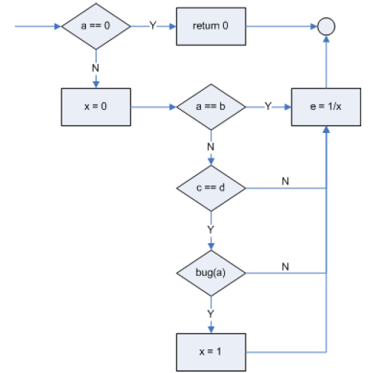

Slide 32
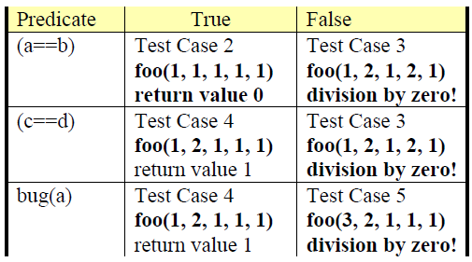

Slide 33
SOFTWARE REQUIREMENT SPECIFICATION
If a player lands on a property owned by other players, he or she needs to pay the rent. If the player does not have enough money, he or she is out of the game. If the property is not owned by any players, and the player has enough money buying the property, he or she may buy the property with the price associated with the property.
Draw a CFG
How many independent paths are present. Show all
independent paths

Slide 34
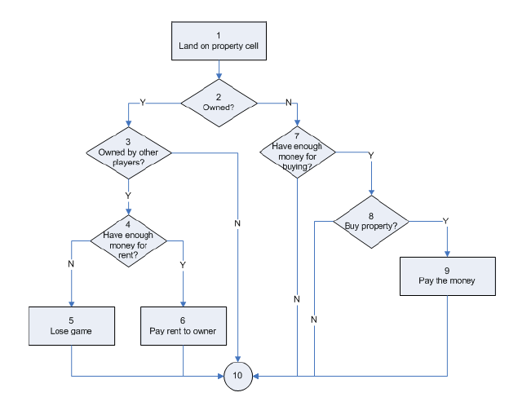

Slide 35
1-2-3-4-5-10 (property owned by others, no money for rent)
1-2-3-4-6-10 (property owned by others, pay rent)
1-2-3-10 (property owned by the player)
1-2-7-10 (property available, don’t have enough money)
1-2-7-8-10 (property available, have money, don’t want to buy it)
1-2-7-8-9-10 (property available, have money, and buy it)

